Slide 1



DEPARTMENT OF ELECTRONICS AND COMMUNICATIONENGINEERING
18ECP105J-MINOR PROJECT-III
FIRST REVIEW
MONITORING SUSPICIOUS DISCUSS ON ONLINE PORTAL
GUIDE BY:
MR.L.RAMESH
PRESENTED BY:
MONISHA A - 927621BEC129
POORVAJA V S - 927621BEC147

Slide 2
INTRODUCTION
In todays ’s digital landscape , online portal have become essential for business , organisations and individuals alike.
The convenience of online access comes the risk of malicious activities that can threaten the security and integrity of these portal.
Our website like an social media, there will be a unwanted message or unwanted comment the account will be block.

Slide 3
PROBLEM STATEMENT
In the rapidly evolving , digital landscape , online portal have becomes hubs for communication , collaboration , and information sharing . while these platforms foster valuable interactions, we also face a growing challenge in combating suspicious discussions that may include hate speech , harassment , misinformation , and illegal activities. The problem at hand is to develop an effective system for proactively identifying and mitigating suspicious discussions on our online portal , ensuring a safe and inclusive digital environment.

Slide 4
OBJECTIVE
The main objective for this project is to explain monitoring suspicious discussions on your portal using clustering algorithm.
Understanding the types of suspicious activities.
Implementing monitoring and detection strategies.
Responding effectively to potential threats.

Slide 5
EXISTING SYSTEM
The tools and technologies in used for automated content analysis and detection.
Users can report suspicious content and the process for handling these reports.
The team responsible for manual content review and moderation.
Machine learning is utilized to identified pattern of suspicious behaviour.
Real-Time Monitoring tools are used to detect and respond to suspicious activity as it occurs.
Alerts and notification are generated for the moderation team when suspicious activity is detected.
Actions taken against users engaged in suspicious behaviour , such as warnings , suspensions or bans.

Slide 6
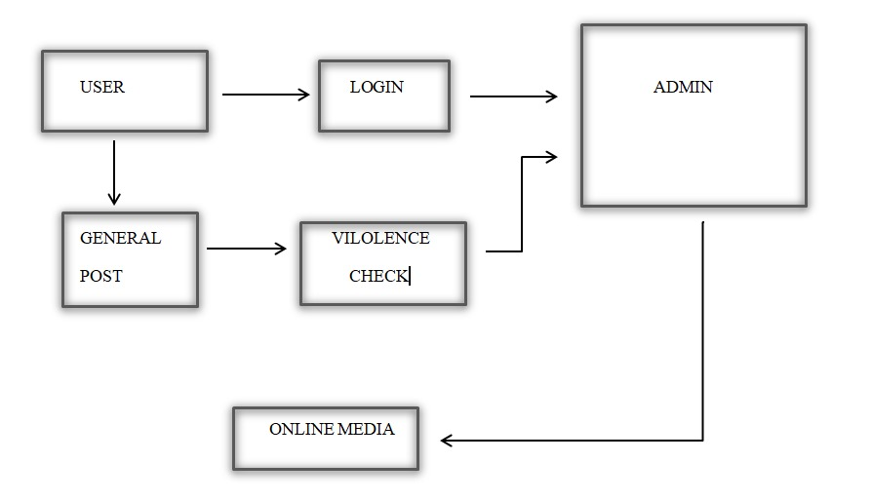
PROPOSED SYSTEM DIAGRAM

Slide 7
COMPARSION
EXISTING SYSTEM | PROPOSED SYSTEM
Content Moderation Tools | Data collection & Data preprocessing
User Reporting System | Feature selection
Human Moderation team | Clustering Algorithm
Machine Learning Integration | Suspiciousness Metrics
Real-Time Monitoring | Real-Time Monitoring
Alerts and Notification | Alerts and Notification
User consequences | Send Email for user

Slide 8
MODULES IDENTIFIED
User authentication and access controls
Logging and auditing practices.
Intrusion detection systems.
User behaviour analytics.
Warning through an email by admin.
Geolocation filtering.

Slide 9
CONCLUSION
Our main conclusion, sage guarding our online portal is a continuous process.
By understanding and monitoring suspicious activities , we can protect our data , users , and reputation in an increasingly digital world.
To emphasize the value of clustering algorithm in monitoring suspicious project.

Slide 10
REFERENCE
[1] Murugesan, M. Sururthi, R. Pavitha Devi, S. Deepthi, V. Shri Lavanya, and Annie Princy. Automated Monitoring Suspicious Discussions on Online Formus Using Data Mining Statistical Corpus Based Approach. Imperial Journal of Interdisiplinary Research (IJIR) Vol2, Issue-5, 2016
[2] Javad Hosseinkhani, Mohammad Koochakazei, Solmaaz Keikhaee and Yahaya Hamedi Amin. Detecting Suspicion Information on Web Crime Using Crime Data Mining Techniques. International Journal of Advanced Computer Science and Information Technology (IJACSIT) Vol.-3, No. 1, 2014, Page 32-41
[3] Harika Upgaganlawar, Nilesh Sambhe. Surveillance of Suspicious Discussions on Online Forums Using Text Mining. International Journal of Advances in Electronics and Computer Science, Volume4, Issue-4, April-2017
[4] Social Graph Based Suspicious Chat Log Identification Using Apriori Algorithm and Support Vector Machine Amit Verma1, Sonali Gupta2, Rahul Butail 3, 1Head of the Computer Science Department, 2Assistant Professor, 3Rahul Butail 1, 2, 3 Chandigarh Engineering College, Landran, Punjab, India.

Slide 11


